Slide 1
Noise Pollution monitoring

Slide 2

Problem statement
problem statement for noise pollution monitoring can be defined as follows: “Develop a comprehensive noise pollution monitoring system that can accurately measure, analyze, and report on ambient noise levels in urban and industrial environments. The system should be capable of real-time data collection, long-term trend analysis, and provide actionable insights to mitigate noise pollution and improve the overall quality of life for residents.”

Slide 3
Methodology
Sensor Deployment: Identify strategic locations for noise sensors based on factors like population density, traffic patterns, industrial areas, and noise complaints. Install noise sensors at these locations, ensuring proper calibration and maintenance
Data Collection: Noise sensors continuously collect data, measuring sound levels in decibels (dB). Data should include time and location information to track changes over time and identify sources of noise pollution.

Slide 4
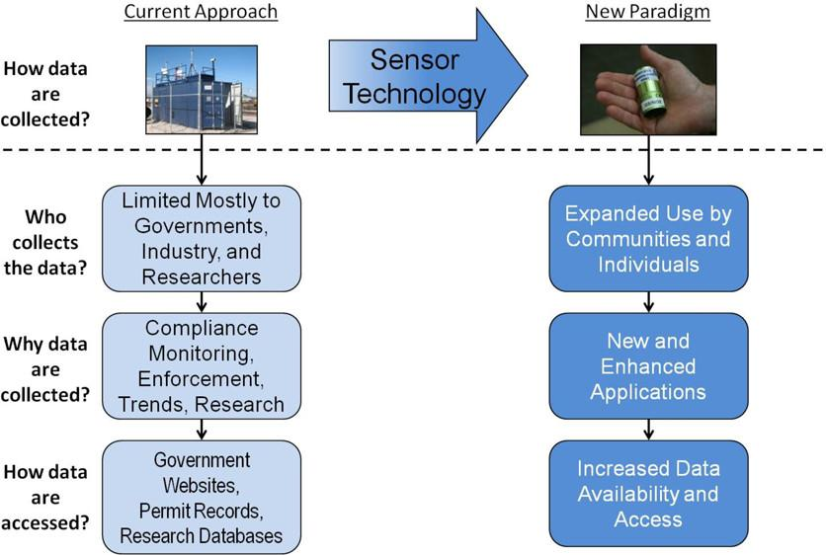

Slide 5
Noise Mapping: Create noise maps using GIS (Geographic Information System) tools to visualize noise pollution levels across different areas. Use color coding to represent noise intensity, helping stakeholders easily identify problem areas.
Noise Mitigation Suggestions: Based on data analysis, provide recommendations for noise mitigation strategies to relevant authorities and businesses. Explore options like noise barriers, traffic management, and noise reduction technologies

Slide 6
Hardware components
Noise sensors
Power supply
GPS module
Cabling and connectors
Remote monitoring and control

Slide 7
Conclusion
Monitoring noise levels contributes to the reduction of stress, sleep disturbances, and other health issues associated with excessive noise exposure.
Noise mapping and data analysis support informed urban planning decisions, helping to design more livable and sustainable cities.
By identifying and mitigating noise pollution hotspots, such a system helps create quieter and more comfortable living environments for residents.

Slide 8
Thank you

